Slide 1
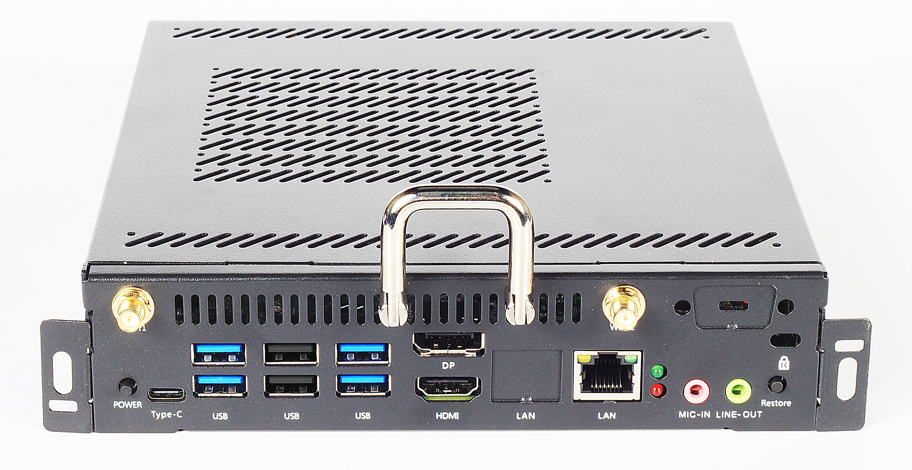





Datasheet OPS
TOP-H584
The product features
Supports Coffee Lake-H 8th 9th Gen Intel ® Core ™i3 i5 i7 processors
The display has HDMI DP and supports synchronous/asynchronous dual display
Compatible with OPS-C full series of products to upgrade and switch
BIOS supports AMI 64Mbit diskless boot power-on and timed boot
JAE 80PIN connection interface is supported
The hardware supports one-click system restoration function
Specifications
Standard parameters | CPU | ®Intel Core™i5-8300H processor, frequency: 2.3GHz, 4 cores and 8 threads
 | memory | 1*SO-DIMM DDR4 2666MHz 8GB memory
 | storage | 1*M.2 2280 port supports NVME and SATA dual protocols (SSD-256G)
 |  | 1* 2.5" SATA HDD
 | Graphics | Intel® UHD Graphics 630
 | Display the output | HDMI/DP Synchronous and asynchronous dual display is supported
 | Internet | LAN | Realtek RTL8111H 10M/100M/1000M Ethernet
 |  | WIFI | 1*M.2 2230 for Wifi+BT 4.2 Dual antennas are supported
 | audio | Realtek ALC887 hd audio 5.1 channel
I/O port | Front-facing interface | 1*HDMI 1.4 out 1*DP 1.2 out 4*USB3.0 2*USB 2.0 1* RJ45 1*Power 1* Reset 1*Line out 1*Mic in 1*Type-C（USB2.0transmit）
 | Rear interface | 1*JAE 80PIN：HDMI out
Power supply parameters | Power input | 19V4.74A
Size parameters | Dimensions of the main unit（mm） | Bare metal: 195*180*30 |  | Box dimensions：282*257*79mm
 | weight（kg） | net weight≈1.2 Kg gross weight≈1.4 Kg
Temperature and humidity. | Operating temperature | 0°C~ 45°C
 | Storage temperature | -40°C~ 80°C
 | Operating humidity | 10% - 95% @40°C No condensation
system | The operating system is supported | Windows 7/10, Linux
Product specifications are for reference only and are subject to change without notice
DS Version:1.0

